Slide 1
Implementation of a new system call
A.Sai Karthik -B150310CS
T.Mahesh Kumar -B150588CS
K.Sai Manoj -B150610CS

Slide 2
New Directory for the new system call
Create a new directory “process_info” and get into this directory.
Create a new file “process_info.c” which actually contains the code for the new system call
Write a make file in the previously mentioned directory which contains
obj-y:=process_info.c
It implies that process_info.c is compiled and included in the kernel source code.

Slide 3
Linking the new system call with kernel
Make sure to add ‘process_info’ directory to the kernel make file.
Through this the compiler will be specified that the source files of the new system can be found in process_info directory

Slide 4

Adding the process_info directory to the kernel makefile.
Setting the compilation file to process_info.o

Slide 5
Changing of syscall_64.tbl
To know the path of this file in your system simply type -
‘find -name syscall_64.tbl’ on terminal
Make sure to include the new system call number and its entry point.

Slide 6
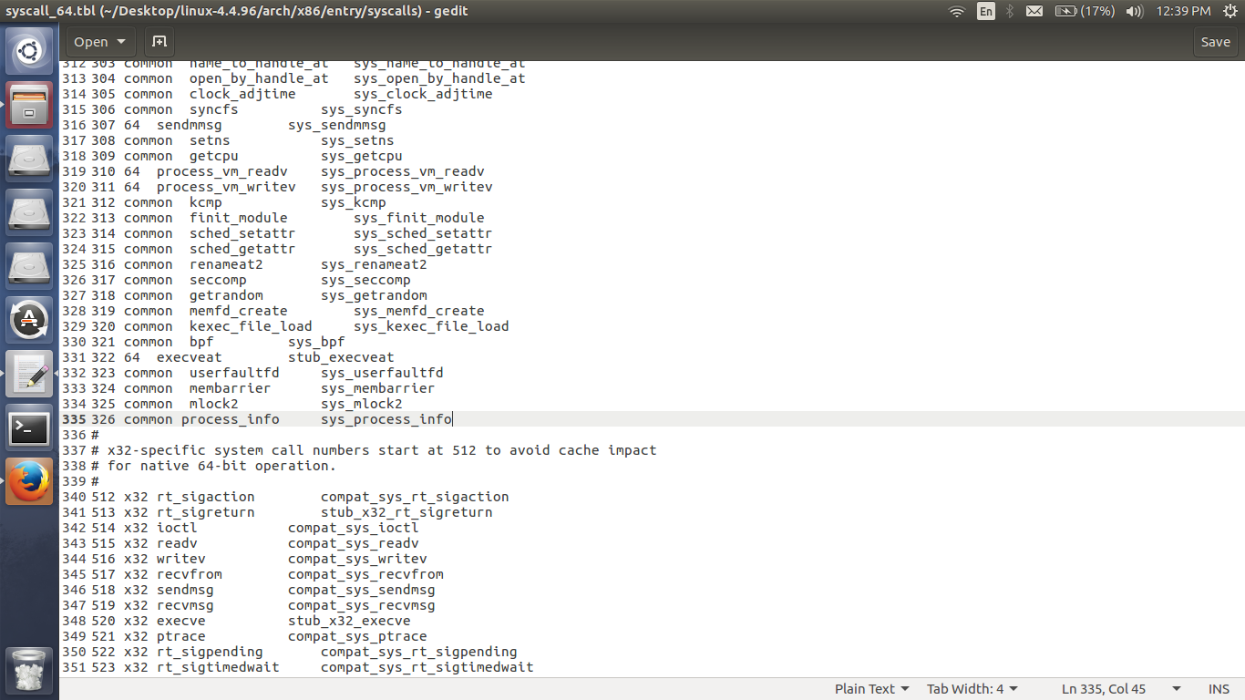

Slide 7
Changing syscalls.h
To know the location of the this file simply type
find -name syscalls.h
Make sure to include the following line at the end of the file
asmlinkage long sys_process_info(void)

Slide 8
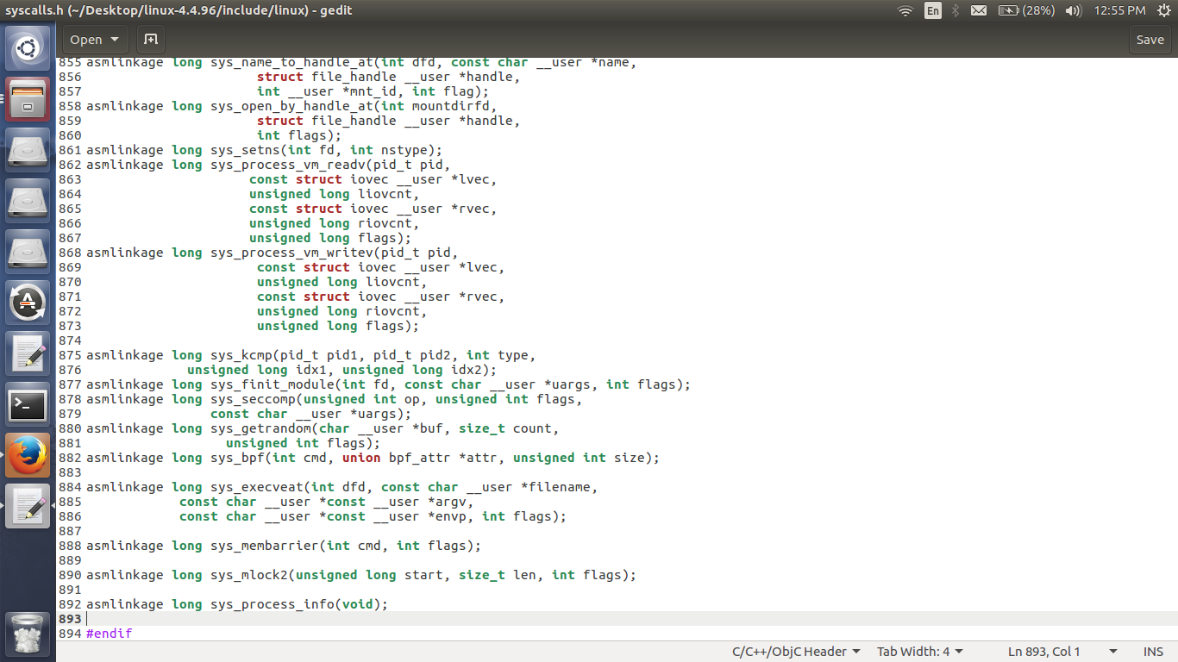

Slide 9
Compiling and booting
To use our new system call we should first recompile the kernel.For this use the following the commands-
sudo make -j 4
sudo make modules_install -j 4
sudo make install -j 4
sudo update grub
Restart the system after the above process.

Slide 10
Testing our new system call
To test the new system call, write a simple ‘test.c’ function.
Compile and execute this program. If it runs successfully, then, it should give the corresponding cause and we can use ‘dmesg’ commande to check the kernel log.

Slide 11
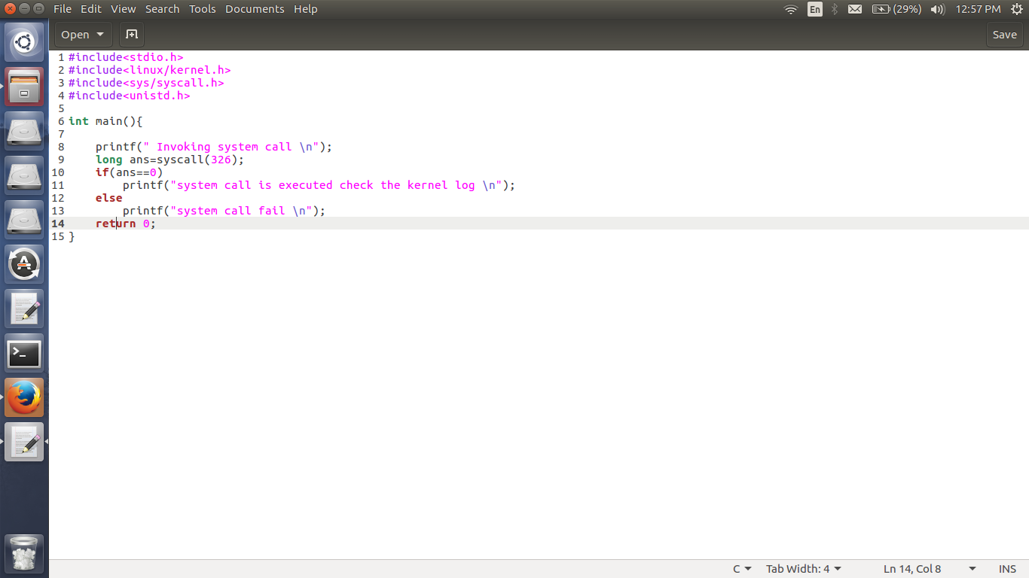

Slide 12
Thank You

